Slide 1
Semiconductors nanocrystals with crystal vibrations
EE683A course project
Presented by:
Neelesh Kumar Vij (170426)
Varun Jindal (15807792)

Slide 2
INTRODUCTION
TO
PROJECT

Slide 3
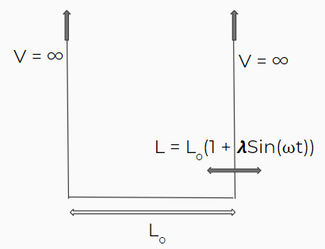
Introduction to project
Semiconductors have atoms arranged in a periodic fashion which oscillate about their mean position.
These vibrations are a function of temperature.
To model this behavior, we consider the crystal lattice points where atoms are present as points of infinite potential.
The vibrations are then considered as time dependent sinusoidal perturbations of these ’infinite potential walls’.

Slide 4
METHODOLOGY

Slide 5
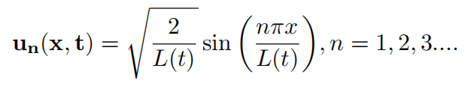
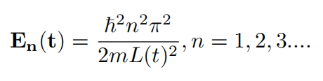
Infinite potential well
The solutions to the unperturbed infinite potential is given by:
With energy of the n^{th} level given by

Slide 6


Setting up Schrodinger Equation
Using these eigenfunctions as basis, any wavefunction can be written by superimposing these eigenfunctions:
The above wavefunction can be found by substituting it in the Schrodinger Equation:

Slide 7
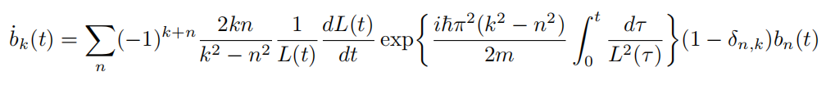

Introducing perturbation
The Schrodinger equation can be solved to give:
To take into account the vibrations as perturbation in the system, we assume the length of the potential well to be:
The value of 𝞴 is << 1 and ⍵ is chosen to match with the frequency of oscillations of lattice atoms.

Slide 8
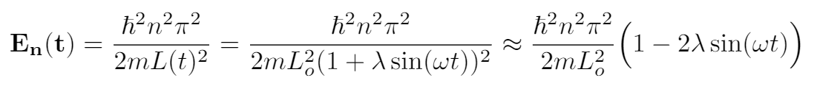
Finding 𝞴 and ⍵
The energy levels of the potential wells have energy of the order of ~ 1000 meV.
The vibrations have energy ~ 1 - 10 meV.
The first term is the energy of unperturbed states and the second term represents the energy of vibrations. Thus, 𝞴 turns out to be ratio of energy of vibrations to the energy of unperturbed states.
⍵ is calculated from the energy of vibrations.

Slide 9
Final equation
Applying suitable approximations, the rate equation simplifies to:
To find the complete wave function 𝚿, we need to calculate the coefficients for which, we solve this coupled differential equation using MATLAB, restricting our basis to only first two eigenfunctions.

Slide 10
PLOTS

Slide 11
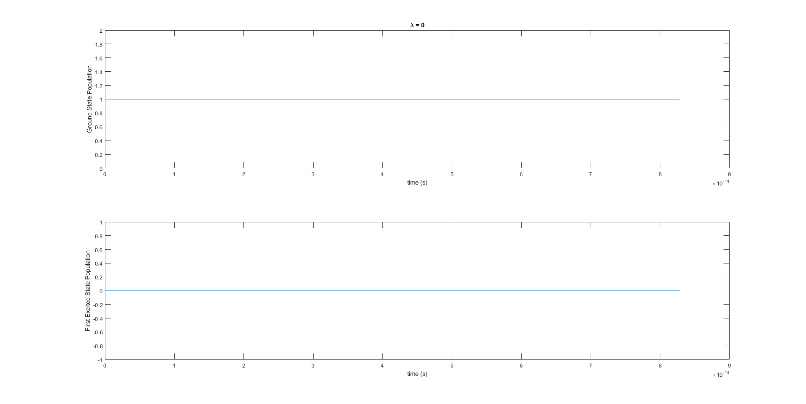
𝞴 = 0

Slide 12
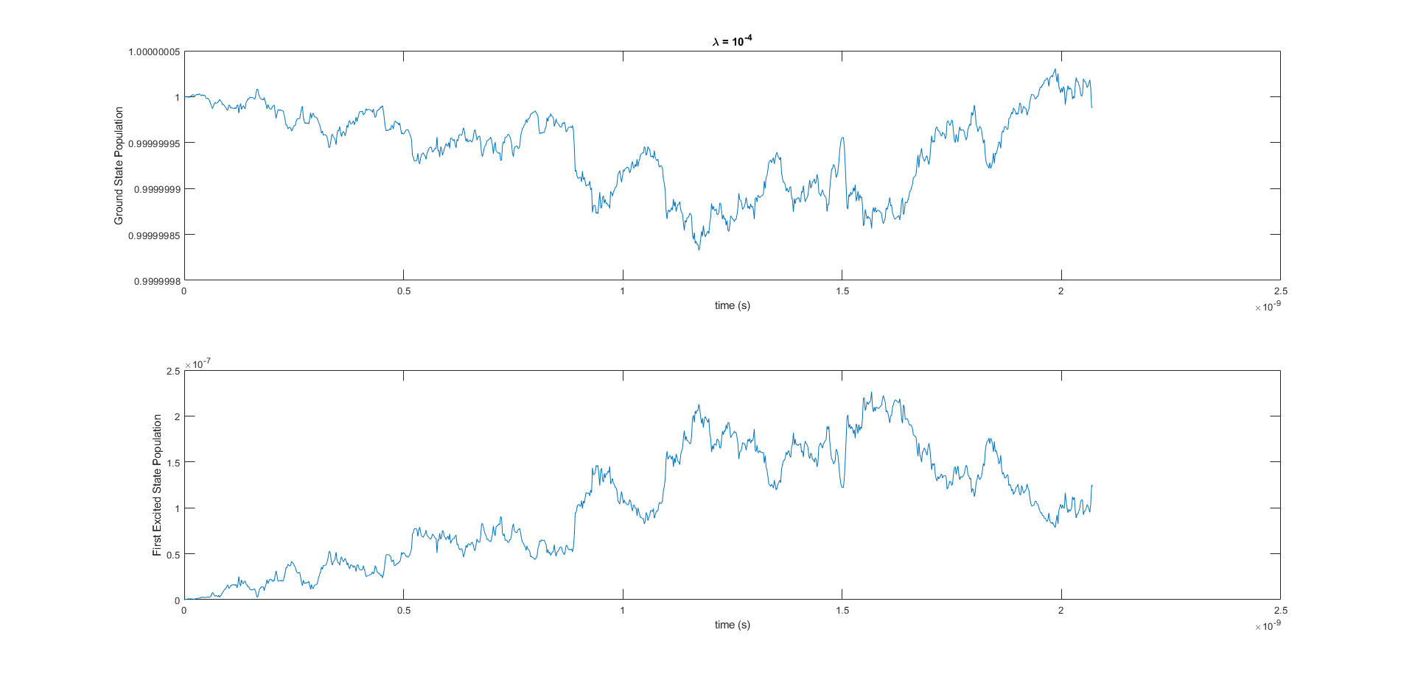
𝞴 = 10⁻⁴

Slide 13
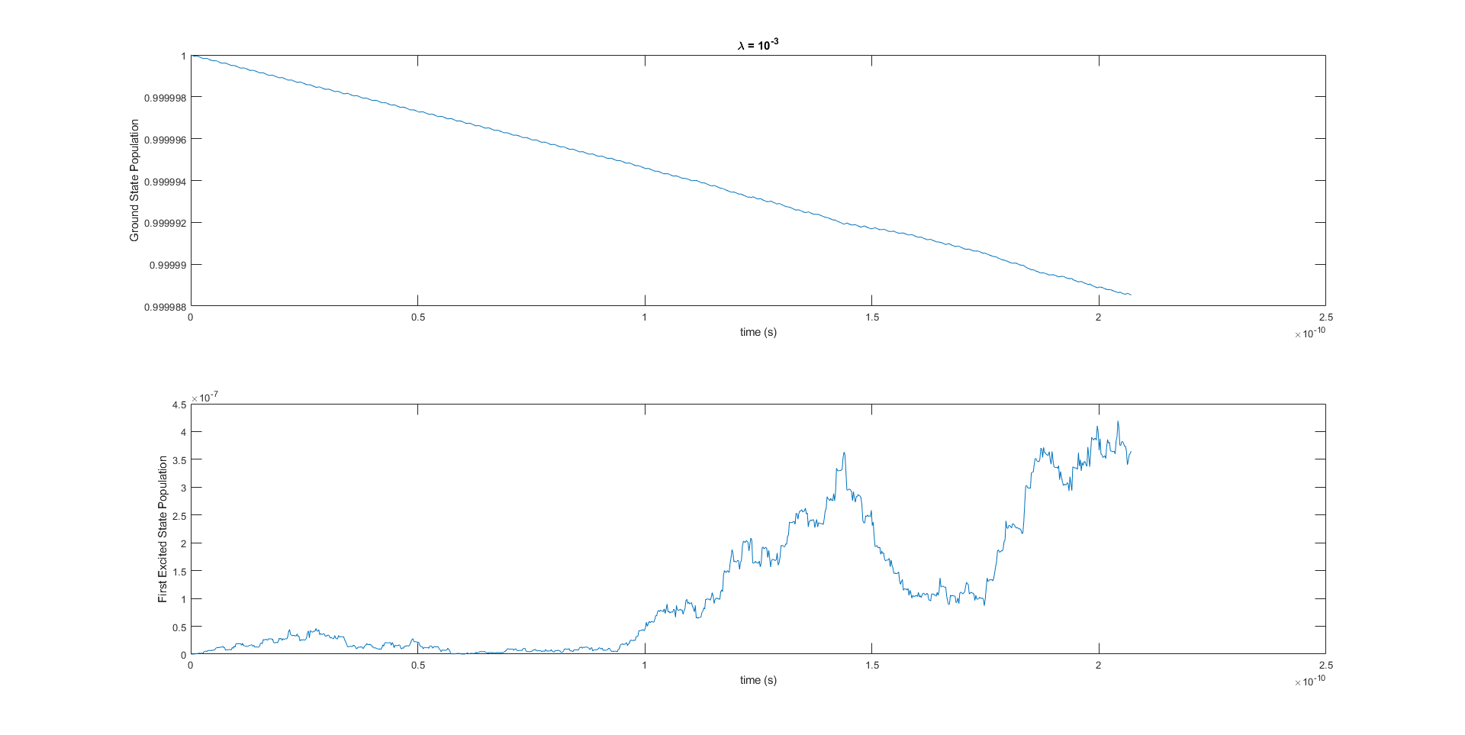
𝞴 = 10⁻³

Slide 14
THANK
YOU!

